Slide 1
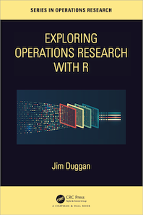
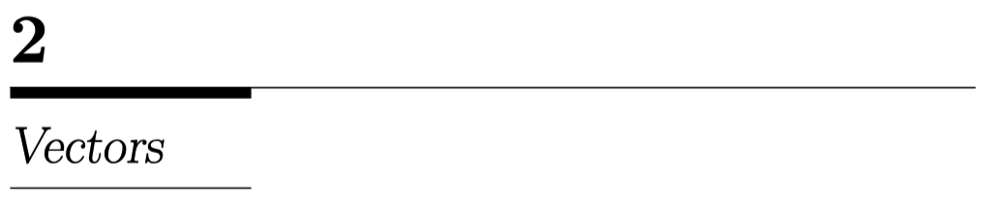

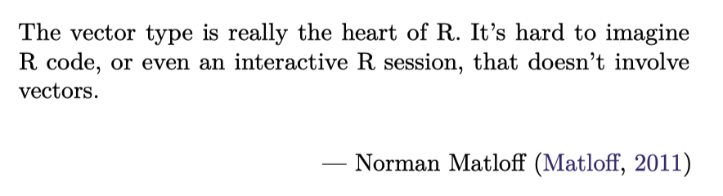
https://github.com/JimDuggan/explore_or

Slide 2
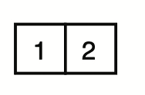
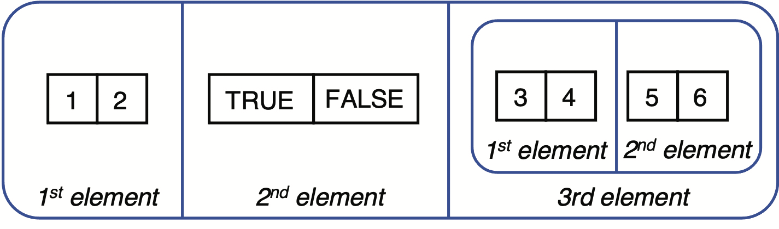
Vectors in R
Knowledge of vectors is fundamental in R.
A vector is a one-dimensional data structure, and there are two types of vectors:
atomic vectors, where all the data must be of the same type, and
lists, which are more flexible and each element’s type can vary
Vectors are contiguous (elements side-by-side in memory)
An atomic vector containing 2 elements
A list containing 3 elements

Slide 3
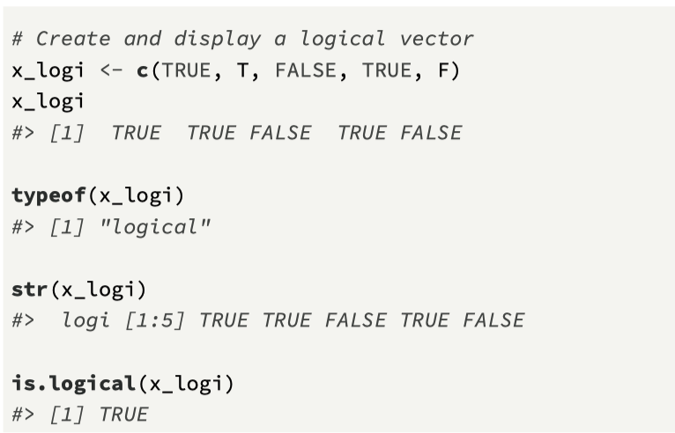
Atomic Vectors – 4 main types
In order to create an atomic vector, the function c() is used, along with the assignment statement <-
Four main types
logical (TRUE/FALSE)
integer (whole numbers)
double (floating point numbers)
character (string format)
integer and double are also known as numeric vectors
typeof(), str(), and is.<type>() are useful

Slide 4
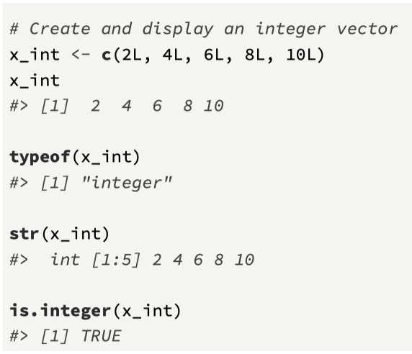
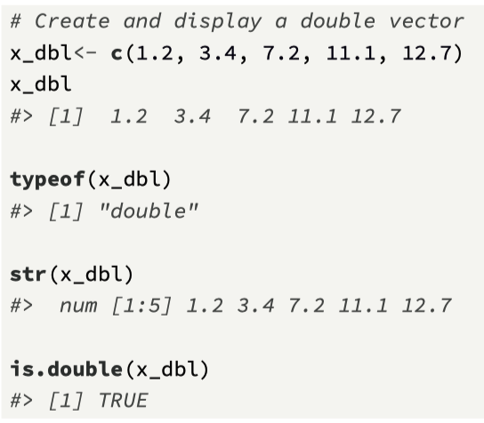
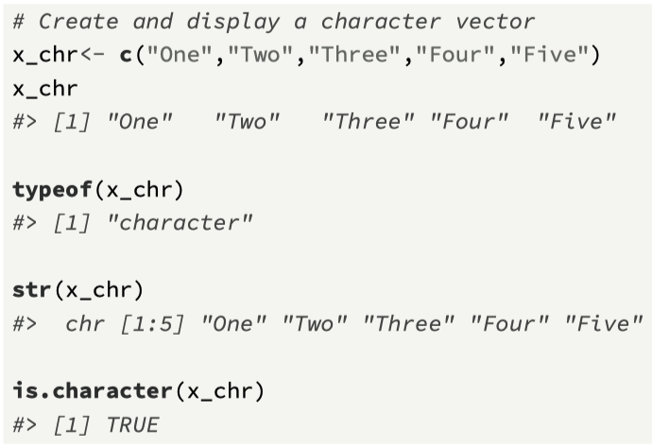
Remaining examples...

Slide 5
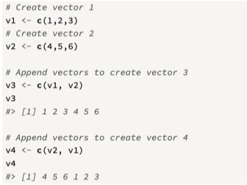
Using c() to append atomic vectors
A further feature of the c() function is that a number of atomic vectors can be appended by including their variable names inside the function call.
We combine the variables v1 and v2 to generate new variables v3 and v4

Slide 6
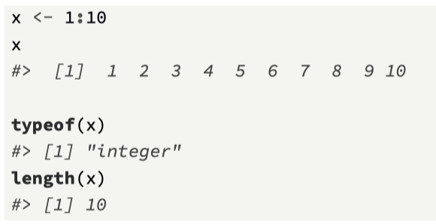
Creating larger atomic vectors
Alternatives to the c() function:
The colon operator : which generates a regular sequence of integers as an atomic vector, from a starting value to the end of a sequence.
seq(), which generates a regular sequence from a starting value (from) to a final value (to) and also allows for an increment between each value (by)
rep() replicates values contained in the input vector, a given number of times
vector() function creates a vector of a fixed length, and sets initial values

Slide 7
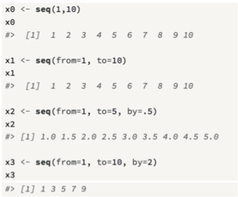
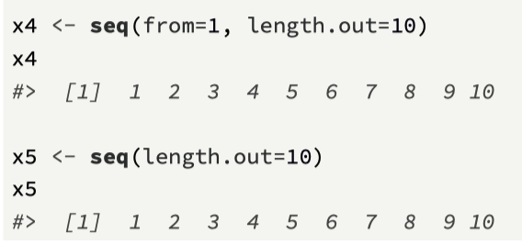
seq() function

Slide 8
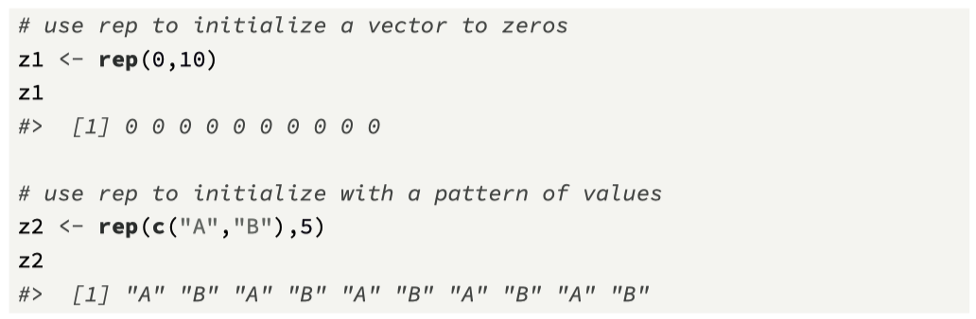
rep() function

Slide 9
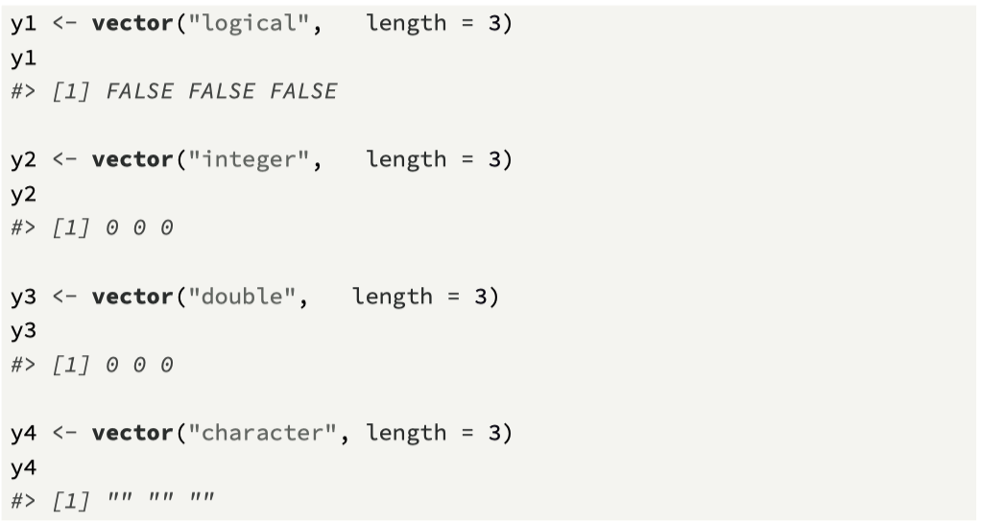
The vector() function

Slide 10
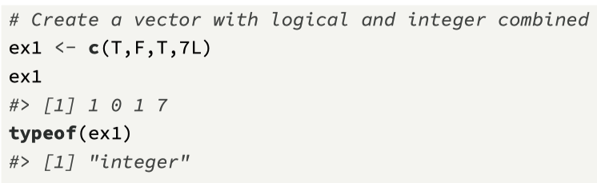
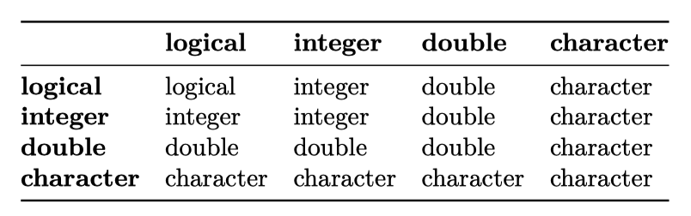
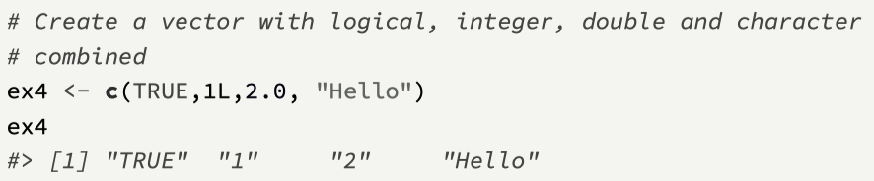
The rules of coercion
All the elements of an atomic vector must be of the same type.
R enforces this through a process known as coercion.
The idea is that if types are mixed in an atomic vector, R will coerce to the most flexible type.

Slide 11
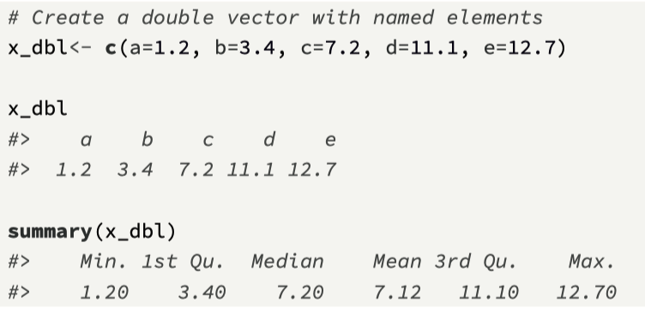
Naming vector elements
An excellent feature of R is that vector elements (both atomic vectors and lists) can be named
There are a number of ways to name vector elements, and the simplest is to declare the name of each element as part of the c() function, using the = symbol

Slide 12
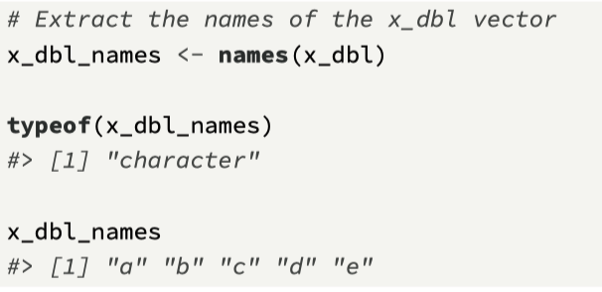
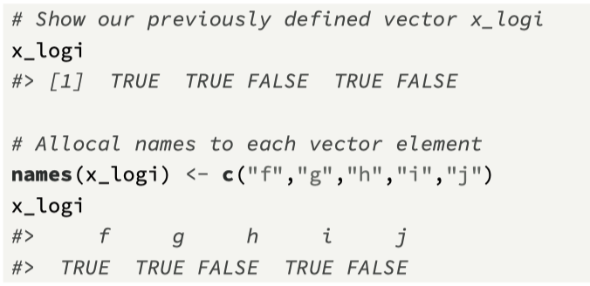
Using names()
A character vector of the element names can be easily extracted using a special R function called names()
names() can be used to:
Retrieve the names of a vector
Set the names of a vector
It is an example of a replacement function
https://stackoverflow.com/questions/11563154/what-are-replacement-functions-in-r

Slide 13
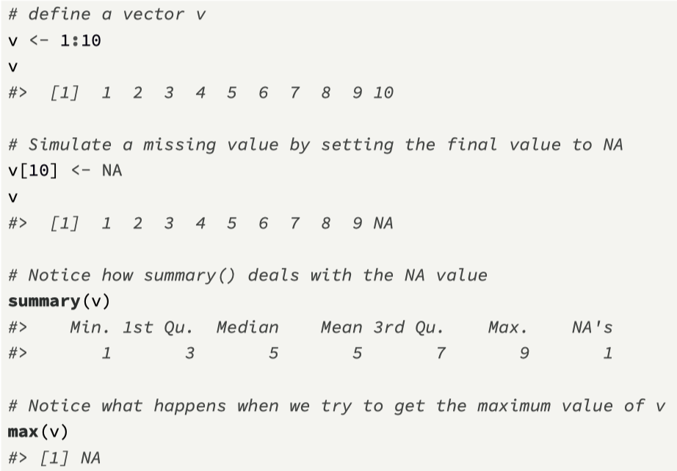
Missing values - introducing NA
When working with real-world data, it is common that there will be missing values (e.g. a temperature sensor might break down)
NA is a logical constant of length one which contains a missing value indicator
Any vector element could have the value NA

Slide 14
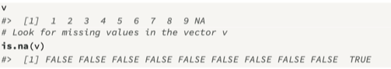
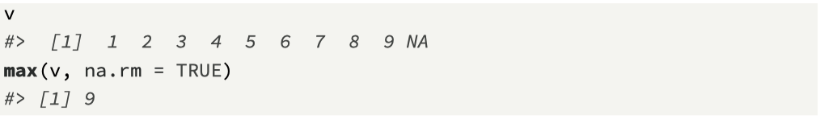
Further information on NA
To check whether NA is present in a vector the function is.na() must be used
To overcome the obstacle of missing values in a vector, we add an additional argument to the max() function which is na.rm=TRUE

Slide 15
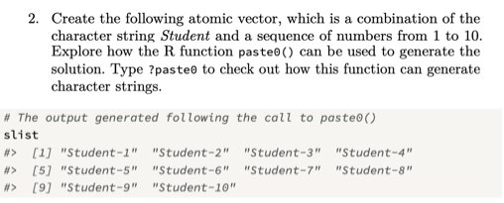
Challenge 2.1

Slide 16
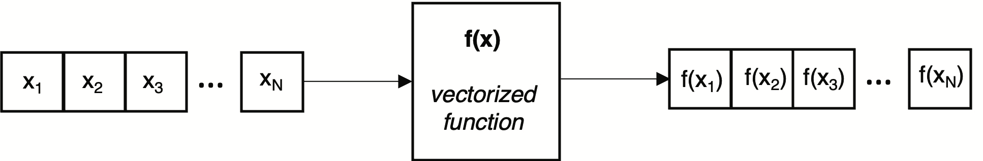
Vectorisation
Vectorization is a powerful R feature that enables a function to operate on all the elements of an input atomic vector, and return the results in an output atomic vector, of the same size.
Removes the requirement to write loop structures to iterate over the entire vector

Slide 17
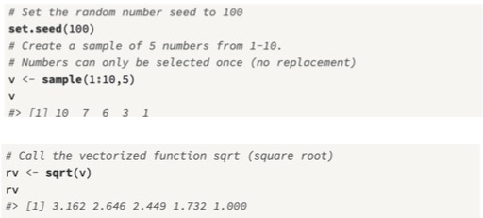
sqrt() is a vectorized function

Slide 18
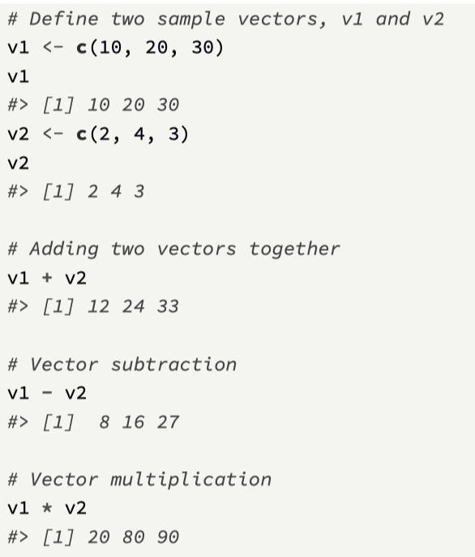
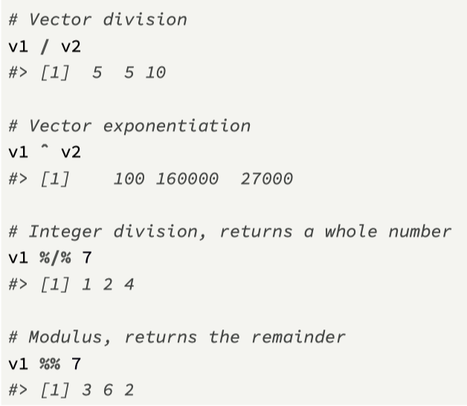
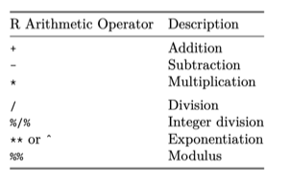
Arithmetic Operators

Slide 19
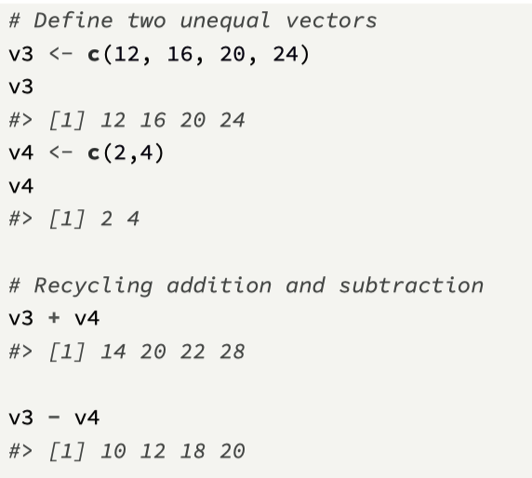
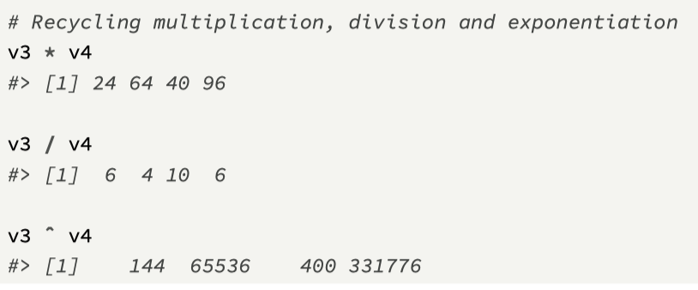
Unequal length vectors – recycling used

Slide 20
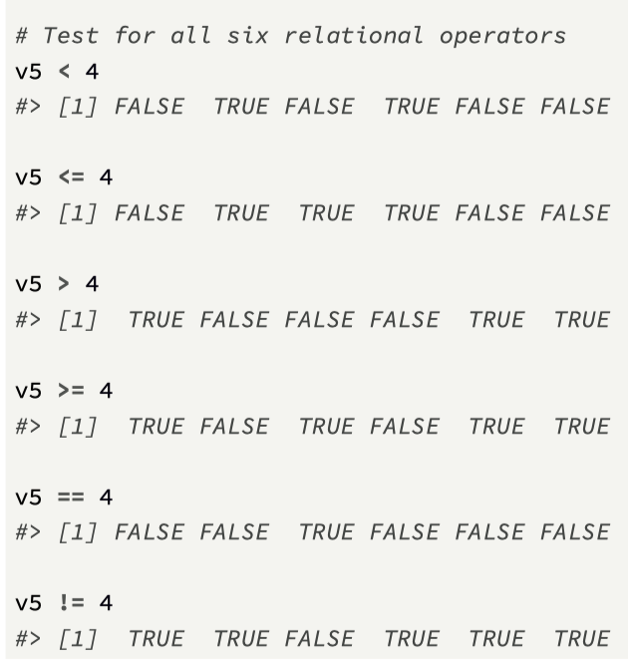
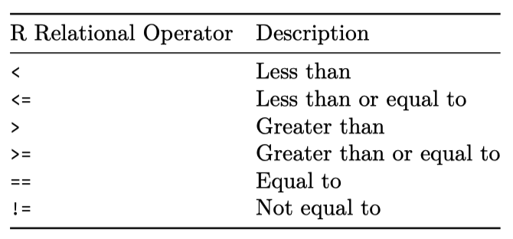
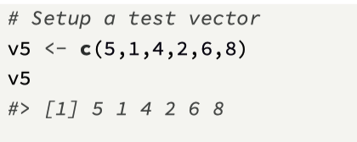
Relational Operators
Relational operators allow for comparison between two values, and they always return a logical vector.

Slide 21
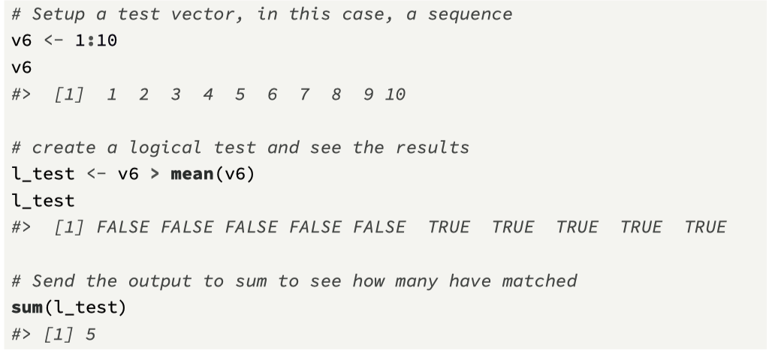
Using benefits of coercion…
The sum() function will coerce logical values to either ones or zeros. Therefore, it is easy to find the number of values that match the relational expression.

Slide 22
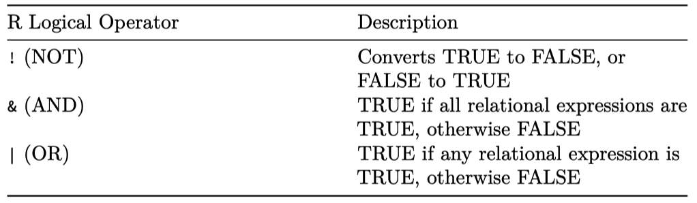
Logical operators
Logical operators perform operations such as AND and NOT, and for atomic vectors, the following logical operators can be used:

Slide 23
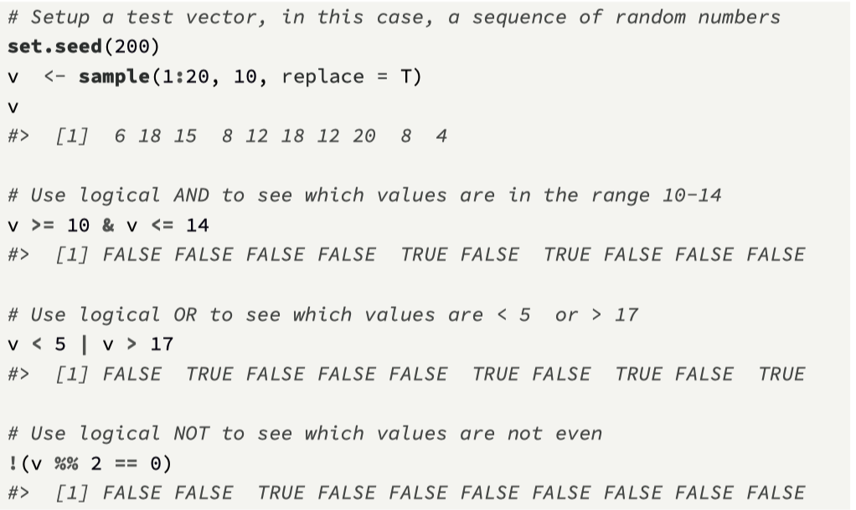
Examples of logical operators

Slide 24
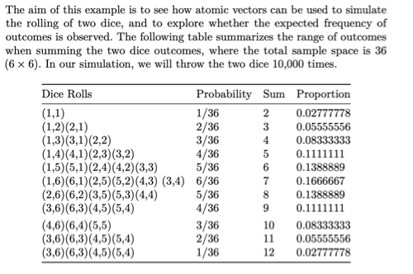
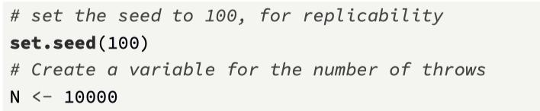
Challenge 2.2

Slide 25
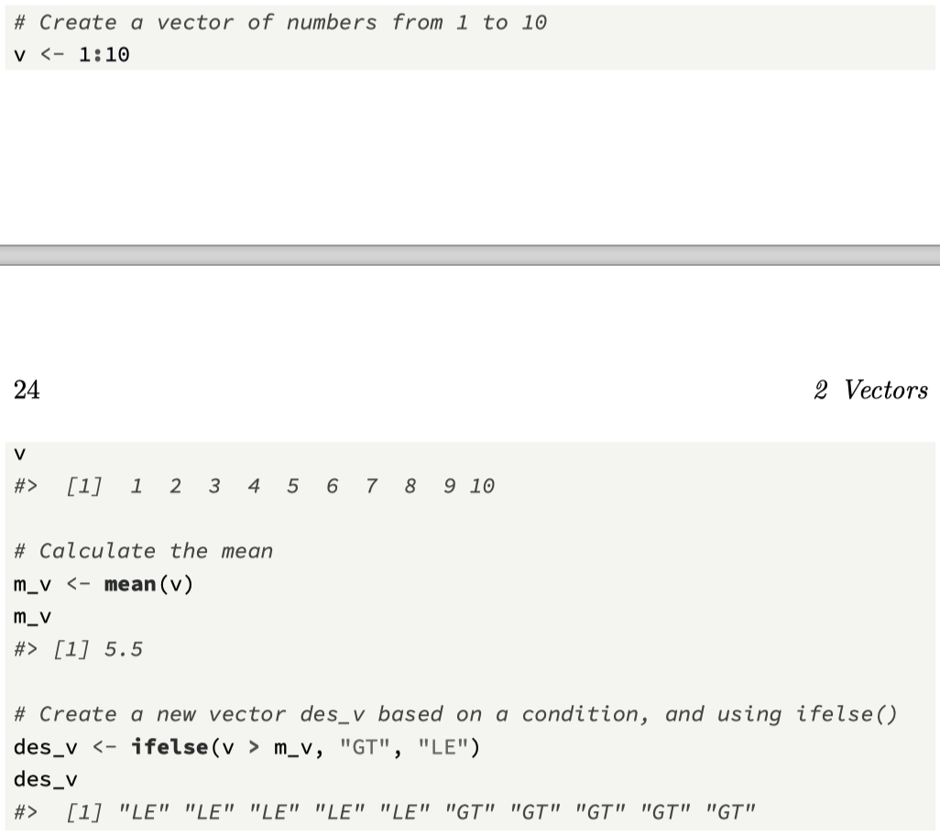
ifelse() vectorised function (looping action)
The ifelse() function allows for successive elements of an atomic vector to be processed with the same test condition.
ifelse(test_condition, true_value, false_value), where:
test_condition is a logical vector, or an operation that yields a logical vector, such as a logical operator
true_value is the new vector value if the condition is true.
false_value is the new vector value if the condition is false.

Slide 26
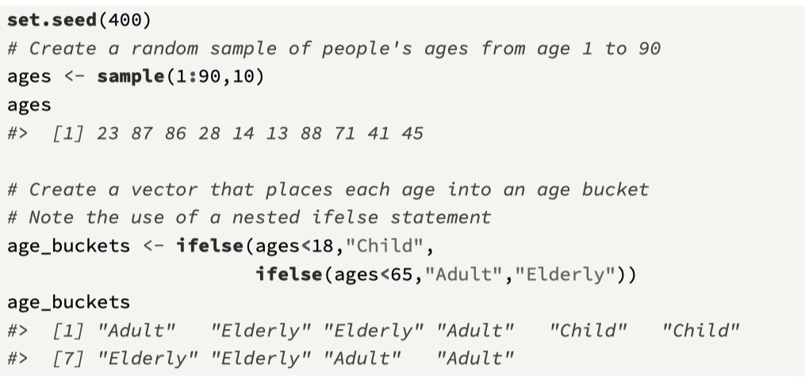
Nested ifelse()

Slide 27
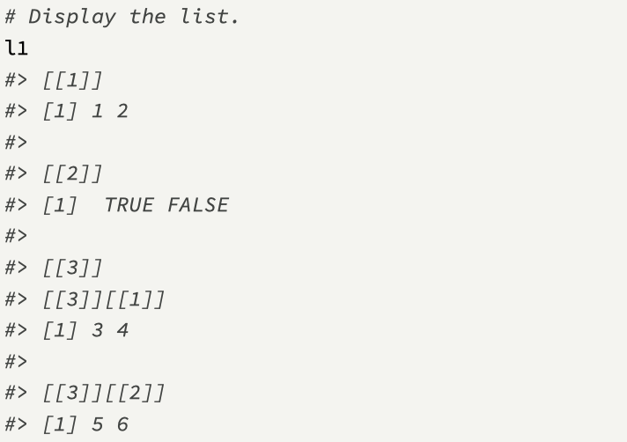
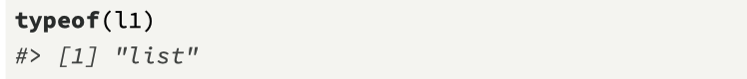
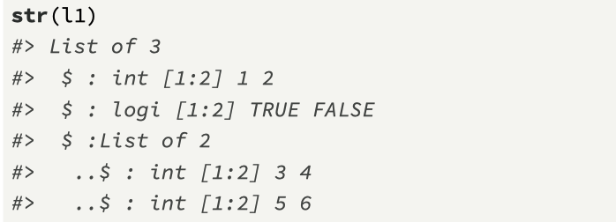
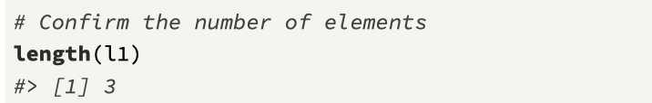
Lists
A list is a vector that can contain different types, including a list.
A list can be defined using the list() function, which is similar to the c() function used to create atomic vectors.

Slide 28
Visualising a list

Slide 29
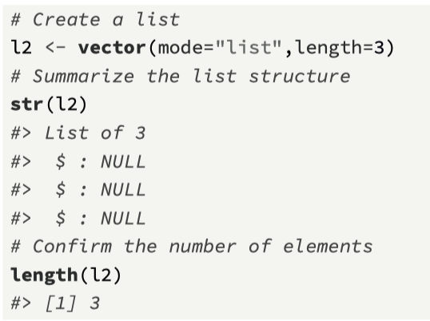
Creating larger lists…
As we have seen with atomic vectors, it can be valuable to create a larger structure that could then be processed using a loop.
With lists, the function vector(), which we have seen used for creating atomic vectors, can also be used to create a list of a given size.

Slide 30
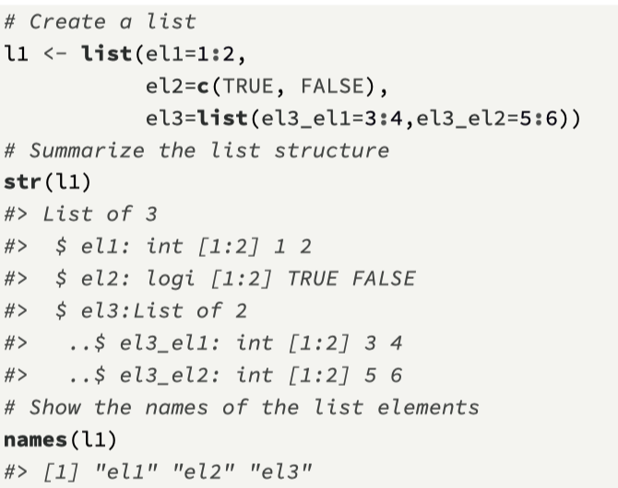
Naming list elements
Similar to atomic vectors, each element of a list can be named.
The main point is that naming list elements is a good idea, and can lead to
(1) increased clarity when using the str() function and
(2) increased flexibility when accessing a list element

Slide 31
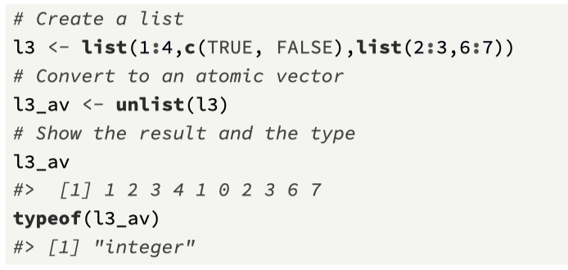
Converting a list to an atomic vector
A list can be converted to an atomic vector using the unlist() function.
This flattens the entire list structure.
Coercion is performed to ensure that all the elements are of the same type.

Slide 32
Chapter 2 Recap
Two kinds of vectors:
Atomic vectors (4 main types), coercion used
Lists
Vector elements can be named
Missing values
Vectorisation
Next Challenge: Vectorised ifelse()
Next Topic: Subsetting Vectors

Slide 33
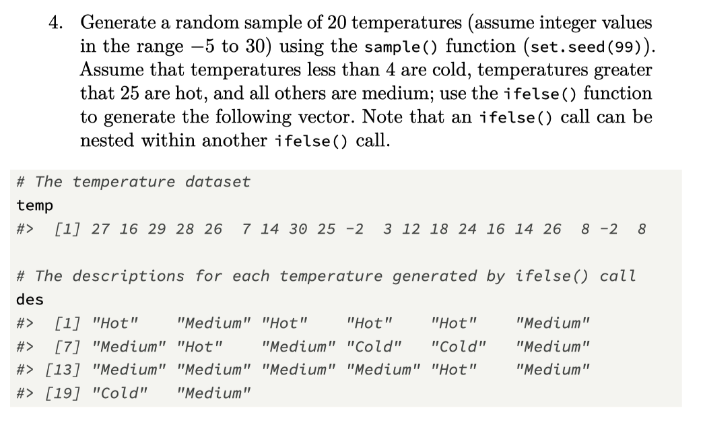
Challenge 2.3

